Slide 1
NEAR supports to investments and engagement with private sector
European Banking Federation
Friday, 7 June 2024
Fulvio Capurso –
EU Commission DG NEAR

Slide 2
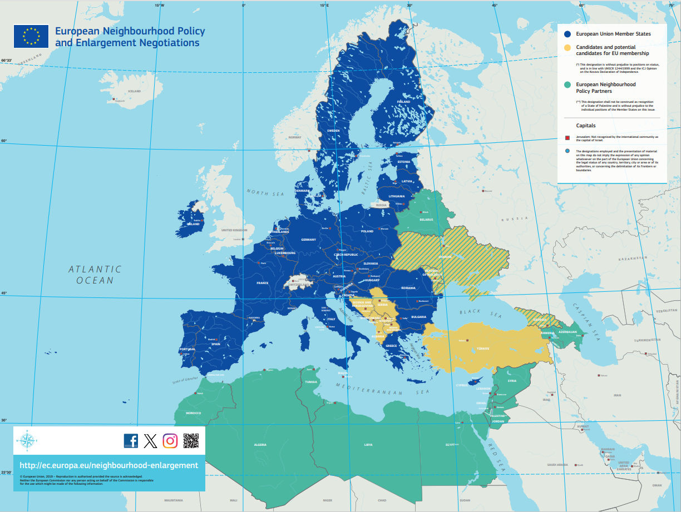


What are the Neighbourhood and Enlargement regions covered by DG NEAR ?
#GlobalGateway #TeamEurope

Slide 3

How is Global Gateway implemented in the NEAR region ?
The Economic and Investment Plans (EIPs) are the regional implementation of Global Gateway in Neighbourhood and Western Balkans
Three EIPs:
  - Eastern Partnership
  - Southern Neighbourhood
  - Western Balkans
Same priority sectors as the rest of GG: digital, climate & energy, transport, health, education & research + important focus on private sector/SMEs development
Ambition to mobilise EUR 77 billion in investments between 2021 and 2027. On good track to deliver: currently EUR 50 billion expected mobilised investments through 484 operations.
#GlobalGateway #TeamEurope

Slide 4
EFSD+ Key Features
  Size: Eur 40bn guarantee
  Geographic scope: Global
  Scope: full spectrum of investment from sovereign to private sector
  Policy first: Programmed to ensure alignment with national and regional priorities
  Open and collaborative architecture
  Financial Instruments combined with policy reforms and TA

Slide 5

EFSD+: EU Budgetary Guarantee
  Unfunded Guarantee backed by the EU budget (AAA)
  Unconditional, irrevocable guarantee on first demand
  Comprehensive set of risk coverage: commercial, political, currency
  Priced at concessional level based on impact criteria
  Provided via Eligible Partner Financial Institutions (EU and International)
  Catalyse private investments – Market creation/development
Notes:
5

Slide 6
EFSD+ Mobilisation of private investment
EU and Intern. FI
Private Investors
Banks’ lending to SMEs
PPPs
Renewable Energy – off take risk
Mobilisation at Project Level
EFSD+
EU and Intern. FI
Private Investors
SDG Funds
Impact Bonds
Syndication Platforms
Mobilisation at Scale
Notes:
6

Slide 7


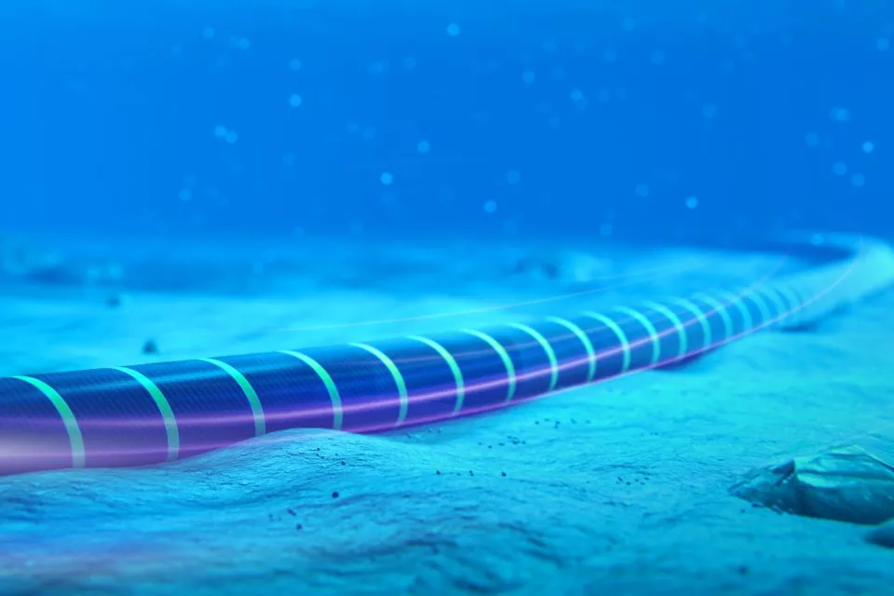




Flagship:
Digital Connectivity
MEDUSA – regional North Africa
€342 M
total investment (estimated)
Partner countries
Algeria, Egypt, Morocco, Tunisia
Objectives
7,100 km high-capacity optical-fibre submarine cable to connect both shores of the Mediterranean Sea. It will integrate 500 universities and research centres from these countries into “EU essential terabit R&D network”. They will receive a 200 Giga bits per second connectivity for the next 20 years. SMEs will also benefit from this enhanced connectivity.
Partners
EU, EIB; AFR-IX Telecom, Alcatel Submarine Networks, ASREN, GEANT, Orange
Implementation stage
- Grant contribution agreement NEAR-EIB signed in July 2023.
- Launch of phase 1 of the project in 2024.
- The project will be operational between 2025 and early 2026 (design life of 25 years)
#GlobalGateway #TeamEurope

Slide 8
Clean energy / Flagship
Energy Connectivity
GREGY project
€3.5 Bn
total investment (estimated)
Partner countries
Egypt and Greece
Objectives
A high-voltage electricity interconnection in the Eastern Mediterranean between Europe and Africa passing from Egypt to Greece. The purpose would be to transmit 3 GW of green power, generated by solar and wind parks in Egypt, to the EU via Greece.
Partners
Greece and other partners. Being determined.
Implementation stage
Feasibility study to be finalised.
Since 25 October 2023, project retained in list of projects of mutual interest (PMI). Formal adoption by EC expected end November and then scrutiny of Council and EP at the beginning of 2024.
#GlobalGateway #TeamEurope

Slide 9
NEAR Task Force
Engagement with Private Sector
Remit
Engage with European private sector to to deliver EU policy objectives
  Objectives
  Delivering the EIP targets: generate EUR 77bn of investments in the Neighb. and the Western Balkans
  Filling the investment gap in strategic sectors, in partner countries
  Contribute to the EU Open Strategic Autonomy
  Contributing to EU economic partnerships with NEAR countries: building on the socio-economic analysis to deliver priority investments

Slide 10
Workstreams
Develop Market Intelligence
Matching Investments with Financial Instruments
Co-design customised solutions/
Pipeline generation

Slide 11
Strengthening Engagement with EBF
  Concrete Initiatives – EIP flagship projects, investment priorities in Ukraine, energy south Med, EU strategic partnerships
  Pipeline-based dialogue EU-IFIs-EBF
  Pilot schemes to be replicated and scaled up

Slide 12

    Thank you
    INTPA-GLOBAL-GATEWAY@ec.europa.eu
    T
THANK YOU
Fulvio Capurso
Head of Sector – EU Guarantees – Private Investment
European Commission, DG NEAR
#Global Gateway #Team Europe

