Slide 1
New EU Term
Main Themes Impacting the Financing of the Economy
16 October 2024
Burçak İNEL, Director, Financing Sustainable Growth

Slide 2
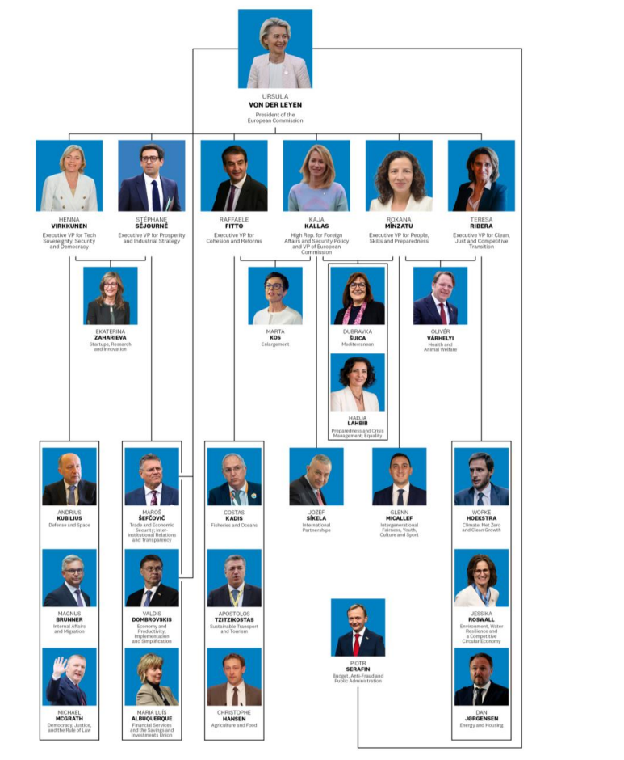
The new European Commission (confirmation expected in November 2024)
Some important policy decisions which lie ahead only referred to lightly, but not detailed in the Mission Letters (eg the size of future joint EU borrowing, components of new resources, degree of convergence of supervisory mechanisms in different sectors).
Overlapping topics dispersed among multiple Commissioners require increased advocacy attention to counterparts beyond the traditional ones focusing on the financial sector.

Slide 3
Over-arching & Inter-related Themes Impacting the Financing of the Economy
Many of the overarching policy themes in the Mission Letters are aligned with the Draghi and Letta reports (plus the Niiniströ report on defense & Strategic Dialogue on the future of EU agriculture).
Competitiveness
  Internal: Single Market; efficiency
  External: Trade & fiscal policies to ensure level playing field/autonomy
Sustainability
Fairness/Cohesion/Convergence
Autonomy/resilience/security

Slide 4
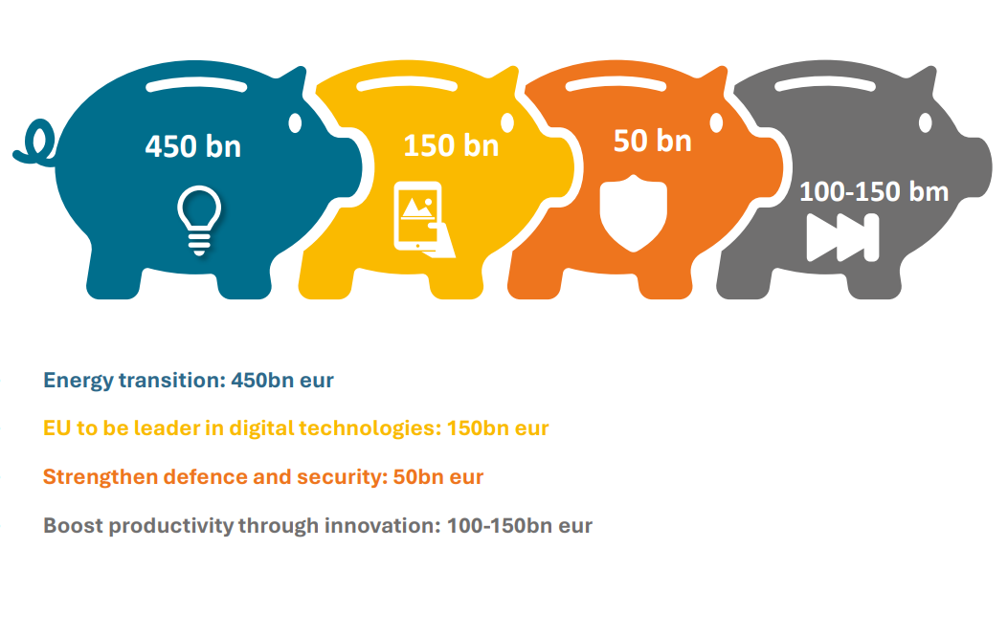
Draghi Report: “The Future of European Competitiveness”
Innovate, decarbonize, increase competitiveness and security, decrease dependency
The report will contribute to the Commission’s work on a new plan for Europe’s sustainable prosperity and competitiveness and to the development of the new Clean Industrial Deal for competitive industries and quality jobs
Reduce capital market fragmentation
Increase the financing capacity of the banking sector
Overcome fragmentation in the Single Market for goods and services
Deploy EU budget more effectively
Issuance of a common safe asset to finance joint investment projects
  Strong focus on investment increase (five % of GDP) – decarbonization/competitiveness and security focus (decarbonization should not lead to de-industrialization)
  Need to accelerate decarbonization, focus on cleantech, decrease of energy prices – cheap clean energy sources, securing value chains (raw materials), removal of barriers, investments in grids, acceleration of permits….
  Improve Carbon Border Adjustment Mechanism, increase LPF
  Consider defense “ESG compliant”
  Need for simplification of the regulation on sustainable finance and access to finance for SMEs No significant new legislation expected on sustainable finance

Slide 5
Potential impact on clients of banks (households & companies) will come from:
  Greater alignment of incentives for economic activity on the ground
  Increased volume of EU public sector funding available for sustainability investments by households and corporates to make them bankable
  Boosting innovation funding esp through increased access to VC/risk capital
  Boosting competitiveness esp through the “Competitiveness Coordination Tool” in conjunction with the future European Competitiveness Fund and set-up of new Important Projects of Common European Interest (IPCEIs)
  Revised regulatory framework for smaller companies including a new SME passport and a new category of small midcaps
  A new SME and competitiveness check for all new legislation
  Removal of barriers to the Single Market for goods & services
  A single market for sustainable products
  Enhancing the role of the EIF to step up financing for high-potential & fast-growing European companies
  Incentivizing public & private investment in defense, notably with the EIB, other financial institutions and private banks

Slide 6
Potential direct impact on banks or their financial sector counterparts will come from:
  CMU integration/deepening
  “Quick progress on the digital euro project”
  Greater degree of corporate consolidation in all sectors, including the financial sector, including through a tax framework for the financial sector to further integrate the sector, facilitate cross-border operations & foster digitalization/innovation and removal of barriers to the consolidation of stock exchanges and post-trading infrastructure
  Potential private and occupational pensions
  “Simple & low-cost saving and investment products at EU level, along with possible tax incentives”
  “Improved supervisory system”
  “A way forward on EDIS”
  Reform of the securitization framework (plus a pan-European Investment Platform for affordable and sustainable housing)
  Digital finance and payments
  AI deployment in the financial sector
  Launch of AMLA
  Strategy on financial literacy

Slide 7

Accession Countries
Portfolio: Commissioner for Enlargement
Merit-based
Structural reforms, political commitment
Gradual integration of candidate countries supported by various instruments and facilities
Rule of law & fundamental values
Continued & sustained support of Ukraine
Reversible approach to Turkey
Black Sea Strategy
Coordinated support for Southern Caucuses

